Slide 1
Image Classification

Slide 2
Example/Use Case: Food Production
Artificial Intelligence & Machine Learning help automate produce sorting.
ML models can recognize ripe vs. unripe, good vs. bad fruit.
Used in IoT devices, factories, and warehouses.
Our Objective today:
  Use image classification for food sorting.
  Train, Test, and Retrain an image classifier.

Slide 3
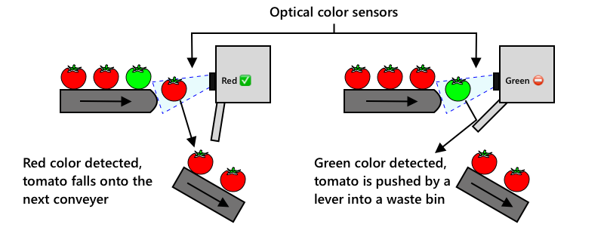
AI, ML, and IoT in Agri Tech
Automation in Agri Tech
  Reduces labour costs.
  Already have machinery harvests faster but
  Lacks sorting ability
Evolution of Produce Sorting
Manual
Workers inspect produce
Optical
Colour Based detection
AI Based Sorting
Detect subtle differences(disease, buising

Slide 4
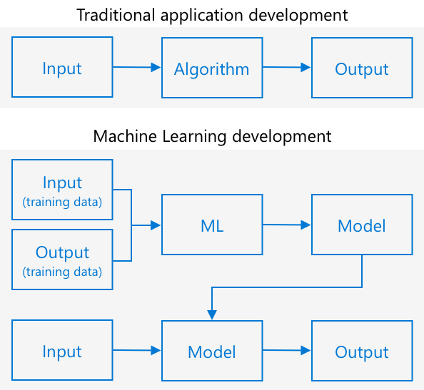
Image Classification using Machine Learning
How ML works:
  Traditional programming: Algorithm + Data = Output.
  ML: Data + Output → Trained Model, which can predict new results.

Slide 5
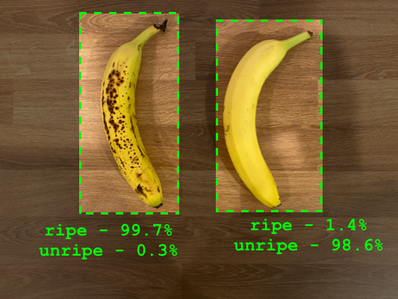
Image Classification – Bananas!
Example: Bananas!
  Trained on images of ripe & unripe bananas.
  Predicts probabilities instead of a strict yes/no answer.
Key terms:
  Training: Learning from labelled data.
  Model: The trained ML algorithm.
  Predictions: Model-generated results.

Slide 6
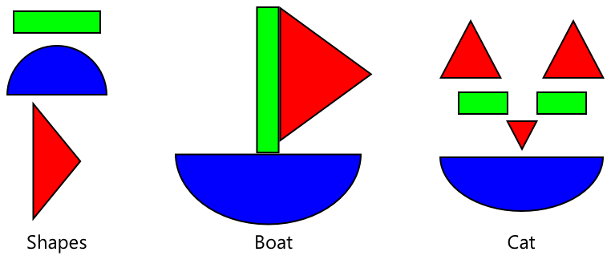
Training an Image Classifier
Uses a pre-trained model to classify new images with fewer examples.
Uses Transfer Learning is where you transfer the learning from an existing ML model to a new model based off new data
Saves computation – models already recognise shapes & textures.
Requires fewer images – trains with 30+ images instead of millions.
Example: Recognising a sailboat from basic shapes.

Slide 7

Microsoft Custom Vision
A cloud-based AI tool for training image classifiers.
Uses a small number of images to build accurate models.
How it works:
  Upload & tag images (e.g., "ripe" or "unripe")
  Train the model
  Test & refine the model
  Deploy via API or SDK

Slide 8

AI & ML Tools
MS Cognitive Services on Azure include:
  Custom Vision, speech recognition, and language tools

